Slide 1
Together- A wearable technology for group management
By:
Dhruvatara B
Hima Deo
Jai Lulla
Faizan Khan

Slide 2
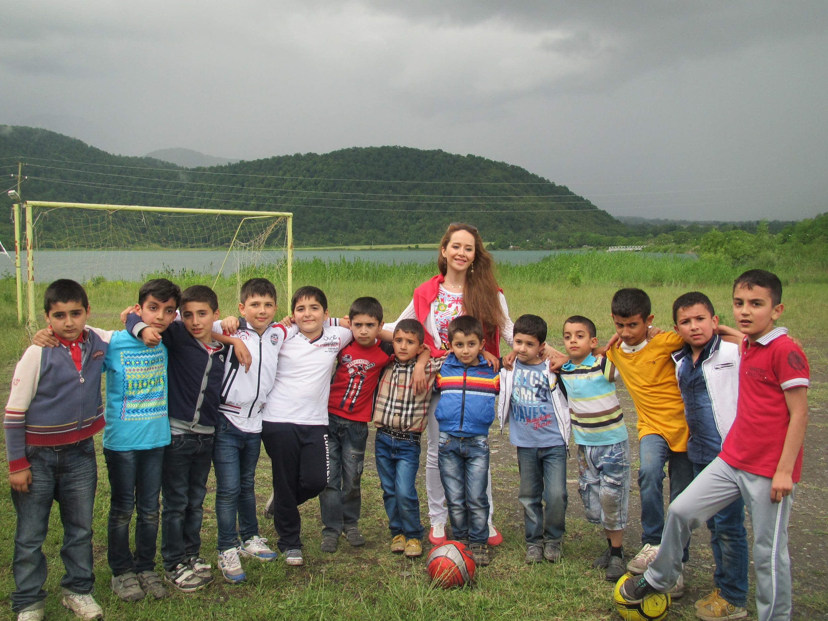
Introduction
Considered our final year project as a system for applying the concepts of Human Computer Interaction to it.
Our system is a wearable technology for group management.

Slide 3
Identifying specialised users
Interfaces involved: Android application and a band with OLED display
Specialised users : Senior citizens, young children, users with visual disability
Suggestions to improve system’s accessibility:
font size, haptic feedback, help button, text to speech output, etc.

Slide 4
Designing user persona
Different user personas are as follows:
Group Leader- Information involved will be:
Name, Demographic profile, End Goal, Scenario.
Student- Information involved will be:
Name, Demographic profile.

Slide 5
Conducting a contextual inquiry
Users are asked a set of standard questions and observations are made in the specific environment.
Four principles of contextual inquiry: Focus, Context, Partnership, Interpretation
Applying the questionnaire and principles, problem are understood and changes are made accordingly.

Slide 6
Designing interface prototype
UI Prototype can be used for: analysis artifact, design artifact, improving usability, potential foundation, etc.
Consider the system and its interfaces and design and build suitable prototype for it.
For betterment, various prototyping tools can be used: Adobe XD, Sketch, etc.

Slide 7
Evaluating an interface using usability evaluation technique
Purpose: improving the usability of the system and assess the extent to which the usability objectives have been achieved
Some techniques are: Heuristic evaluation, Questionnaire, Cognitive walkthrough, etc.
For evaluation, apply the 10 Heuristics proposed by Jacob Nielsen.

Slide 8
